Slide 1
Why Jeffery Lin Touches People
Exploring the impact of Jeffery Lin's touch on individuals

Slide 2
Who is Jeffery Lin?
1. Jeffery Lin is a renowned motivational speaker and life coach.
2. He has been inspiring and touching the lives of people for over a decade.
3. His unique approach and ability to connect with individuals make him truly extraordinary.

Slide 3

The Power of Personal Touch
1. Jeffery Lin's touch is not physical, but rather emotional and psychological.
2. He has the extraordinary ability to understand and empathize with individuals on a deep level.

Slide 4
Impact on Personal Growth
1. Through his touch, Jeffery Lin helps individuals discover their true potential.
2. He encourages personal growth, self-reflection, and self-improvement.
3. Many people credit him for their transformation and success in various aspects of life.

Slide 5
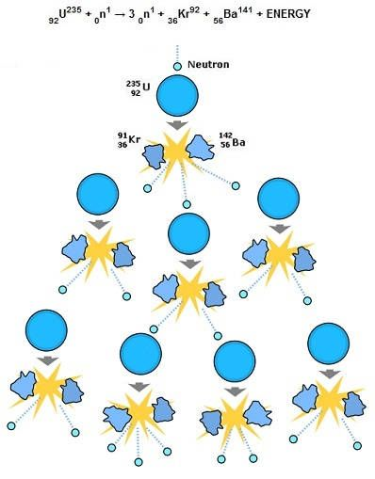
The Ripple Effect
1. Jeffery Lin's touch not only impacts individuals but also creates a ripple effect on their surroundings.
2. People inspired by him go on to touch the lives of others, creating a positive chain reaction.

Slide 6
Thank You

